Slide 1

Rationale
Introduction to Windows Store App Development Using HTML5 and JavaScript
Computer science is a field of study that deals with solving a variety of problems by using computers.
  To solve a given problem by using computers, you need to design an algorithm for it.
Multiple algorithms can be designed to solve a particular problem.
An algorithm that provides the maximum efficiency should be used for solving the problem.
  The efficiency of an algorithm can be improved by using an appropriate data structure.
Data structures help in creating programs that are simple, reusable, and easy to maintain.
This module will enable a learner to select and implement an appropriate data structure and algorithm to solve a given programming problem.

Slide 2
Objectives
  In this session, you will learn to:
  Access files
Notes:
2

Slide 3

Accessing Files
Let us view an animation, which explains storing and accessing persistent data using files

Slide 4

File System Locations Accessible to Windows Store Apps by Default
  Every Windows Store app can access the following locations by default:
App installation directory
App data locations
Downloads folder

Slide 5
File System Locations Accessible to Windows Store Apps by Default (Contd.)
  To access files and folders in the app installation directory, you can:
  Retrieve StorageFolder that represents the app installation directory, as shown in the following code snippet:
      var installedLocation = Windows.ApplicationModel.Package.current.installedLocation;
      installedLocation.getFileAsync("datafile1.txt")
      .done(function (file){ });
  Retrieve a file directly from the app installation directory by using the app URI, as shown in the following code snippet:
    Windows.Storage.StorageFile
    .getFileFromApplicationUriAsync
    ("ms- appx:///datafile1.txt").done(function (file) { });

Slide 6
File System Locations Accessible to Windows Store Apps by Default (Contd.)
  The StorageFile class provides various methods to perform different types of operations on files.
  The commonly-used methods of the StorageFile class are listed in the following table.
Method | Description
copyAndReplaceAsync() | Allows replacing the existing file with the file referred by the storageFile instance.
copyAsync() | Allows creating a copy of the file, referred by the storageFile instance, in the specified destination folder.
deleteAsync() | Allows deleting a file.
openAsync() | Allows opening a file and accessing it through a random-access stream.
openReadAsync() | Allows opening a file, accessing it through a random-access stream, and reading its content.
renameAsync() | Allows renaming a file with the desired name.
getFileFromPathAsync() | Allows retrieving a file from a folder specified by a URI.

Slide 7
File System Locations Accessible to Windows Store Apps by Default (Contd.)
  To access files and folders in the app data locations, you can:
  Retrieve the app data folder by using the properties of the ApplicationData class, as shown in the following code snippet:
    var localFolder = Windows.Storage.ApplicationData.current
    .localFolder;
    localFolder.getFileAsync("datafile1.txt").done
    (function (file){/* Write code for processing the file */ });

Slide 8
File System Locations Accessible to Windows Store Apps by Default (Contd.)
  Retrieve the file directly by using an app URI, as shown in the following code snippet:
    Windows.Storage.StorageFile.getFileFromApplicationUriAsync("ms-appdata:///local/datafile1.txt").done(
    function(file) {
    // Process file
    }
    );

Slide 9
File System Locations Accessible to Windows Store Apps by Default (Contd.)
  You can create a file or a folder in the Downloads folder by using the createFileAsync() method or the createFolderAsync() method.
  The following code snippet shows how to create a file named datafile1.txt in the Downloads folder:
  Windows.Storage.DownloadsFolder.createFileAsync
  ("datafile1.txt").done(
  function(newFile) {
  // Process file
  }
  );

Slide 10

Just a Minute
  Identify the code snippet that allows renaming a file, whose reference is stored in storageFile, with a new name, Data.txt.
  1. storageFile.renameAsync("Data.txt").done();
  2. storageFile.rename("Data.txt").done();
  3. storageFile.renameAsync.rename("Data.txt")
  .done();
  4. storageFile.rename.renameAsync("Data.txt")
  .done();

Slide 11
Just a Minute (Contd.)
  Solution:
  1. storageFile.renameAsync("Data.txt")
  .done();

Slide 12
Accessing Additional File System Locations by Declaring Capabilities
  A Windows Store app can access additional locations by declaring capabilities in the app manifest file, as listed in the following table.
Location | Capability | Storage API
Documents library | DocumentsLibrary | KnownFolders.DocumentsLibrary
Music library | MusicLibrary | KnownFolders.MusicLibrary
Pictures library | PicturesLibrary | KnownFolders.PicturesLibrary
Videos library | VideosLibrary | KnownFolders.VideosLibrary
Homegroup libraries | One or more of the following capabilities is/are needed: MusicLibrary PicturesLibrary VideosLibrary | KnownFolders.HomeGroup
Removable devices | RemovableDevices | KnownFolders.RemovableDevices

Slide 13
Accessing Additional File System Locations by Declaring Capabilities (Contd.)
Location | Capability | Storage API
Media server devices (DLNA) | One or more of the following capabilities is/are needed: MusicLibrary PicturesLibrary VideosLibrary | KnownFolders.MediaServerDevices

Slide 14
Just a Minute
  Identify the storage API that allows access to the Videos folder of a user’s device.
  1. Folders.VideosLibrary
  2. KnownFolders.VideosLibrary
  3. KnownFolder.VideosLibrary
  4. KnownFolders.VideoLibrary

Slide 15
Just a Minute (Contd.)
  Solution:
  2. KnownFolders.VideosLibrary

Slide 16
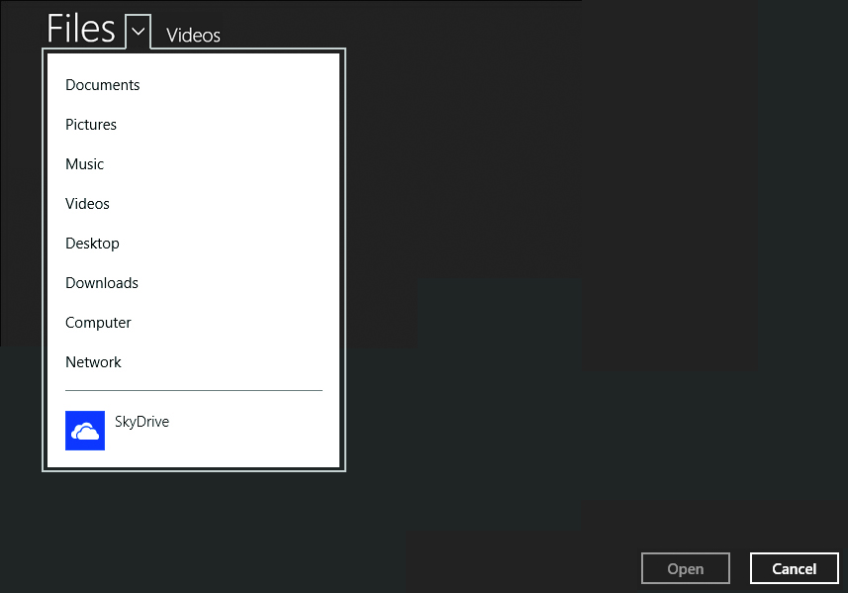
Accessing Additional File System Locations Through File Pickers
  A file picker:
  Allows explicit access to files and folders in an app.
  Allows users to browse the system, and then select or save files.
  Provides a unified interface to allow users to select files and folders from various locations, as shown in the following figure.

Slide 17
Accessing Additional File System Locations Through File Pickers (Contd.)
  A file can be:
  Opened or accessed by using FileOpenPicker.
  Saved by using FileSavePicker.

Slide 18
Accessing Additional File System Locations Through File Pickers (Contd.)
  Using FileOpenPicker:
  To use FileOpenPicker, you need to:
    Ensure that the view state of the app is unsnapped.
    Create an instance of the FileOpenPicker class.
    Set the view mode of the file open picker.
    Set the start location of the file open picker.
    Set the file type filter of the file open picker.
    Use the pickSingleFileAsync() function to pick the selected file.
    Declare the Documents Library capability.
    Define File Type Associations with it to access files from Documents Library.

Slide 19
Accessing Additional File System Locations Through File Pickers (Contd.)
  Using FileSavePicker:
  To use FileSavePicker, you need to:
    Ensure that the view state of the app is unsnapped.
    Create an instance of the FileSavePicker class.
    Set the start location of the file save picker.
    Set the file type choice of the file save picker.
    Set the suggested name for the file being saved.
    Use the pickSaveFileAsync() to save the file.

Slide 20
Accessing Files and Folders in a Particular Folder
  You can access all the files and folders present at a particular location and perform various operations on them.
  To access files and folders in this way, you need to:
Specify the location to be accessed.
Create a collection of files and folders to be accessed.
Perform various operations on them.

Slide 21
Accessing Files and Folders in a Particular Folder (Contd.)
  Example:
  To create a list of text files present in Documents library, you can use the following code snippet:
    var documentsLibrary = Windows.Storage.KnownFolders.documentsLibrary;
    documentsLibrary.getItemsAsync().then(function (items) {
    items.forEach(function (item) {
    if (item.isOfType(Windows.Storage.StorageItemTypes.file)) {
    output.innerHTML += item.name + "<br>";
    }
    });
    });

Slide 22
Accessing Files and Folders in a Particular Folder (Contd.)
  To display the names of all the files in a <div> element, you can use the following code snippet:
    <div id="output" style="padding:10px;
    background-color:aliceblue; color:blue; width:500px; height:700px; overflow:scroll;"></div>
  To execute the preceding code snippet, you need to:
    Set the capability of your app to access Documents library.
    Add File Type Association of text files in the manifest file of the app.

Slide 23
Summary
  In this session, you learned that:
  There are certain file system locations that are accessible to a Windows Store app by default.
  Apart from the default locations accessible to all Windows Store apps, an app can also access additional locations by declaring capabilities in the app manifest file.
  You can use file pickers to explicitly access files and folders in your app.
  You can access all the files and folders present at a particular location and perform various operations on them.
Notes:
23

Slide 24

Q&A

